Slide 1
Stacks

Slide 2
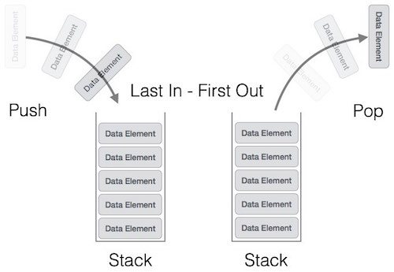
Stacks
Stack is a linear data structure which follows a particular order in which the operations are performed.
The order may be LIFO(Last In First Out) or FILO(First In Last Out).

Slide 3
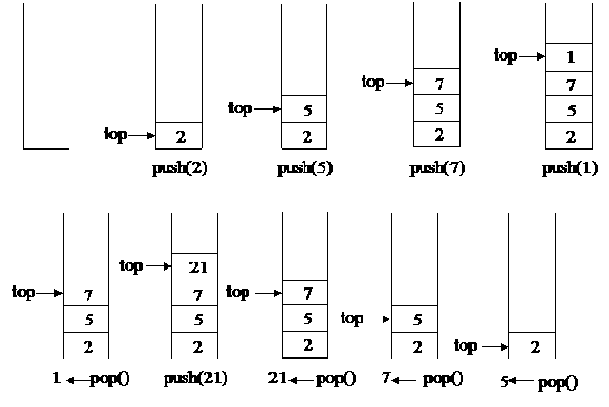
Operation on Stacks
Push operation-The insertion of an element into stack
Pop operation - Deletion of an element from the stack
In stack we always keep track of the last element present in the list with a pointer called top.

Slide 4
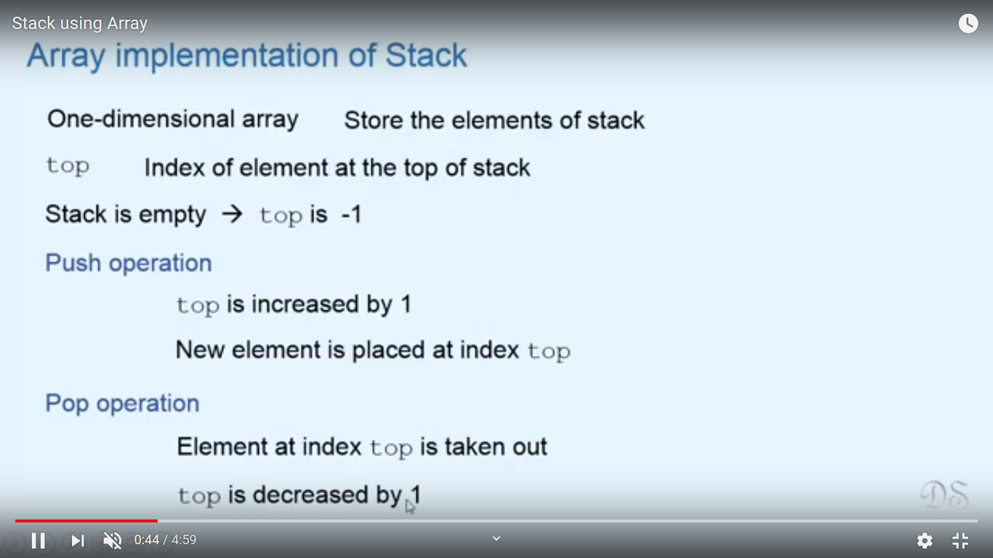
Array Implementation of Stack

Slide 5
Array Implementation of Stack

Slide 6
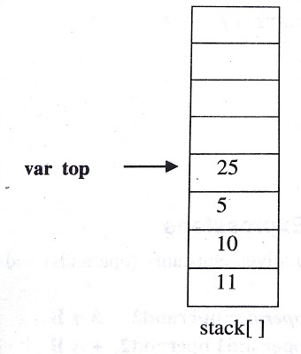
Array Implementation of Stack
Push element one by one onto stack from 0th position to n-1 th position.
Variable top=position of the top element in the array
If there is no element in the stack, value of top will be -1

Slide 7
Stack Overflow /FullCondition
  If(top==MAX-1)
  Then print stack is full or overflowing

Slide 8
Stack Underflow /Empty Condition
  If(top== -1)
  Then print stack is empty or underflowing

Slide 9
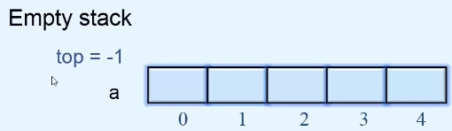
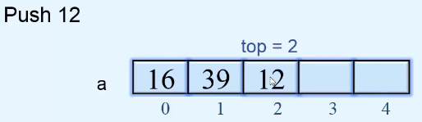
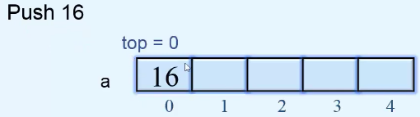
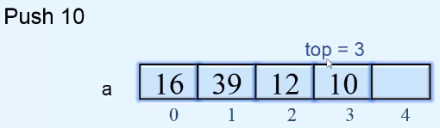
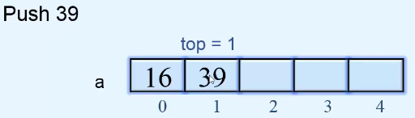
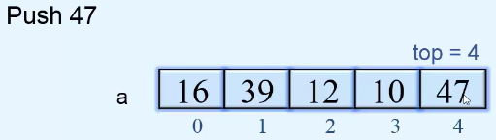
PUSH Operation on Stack

Slide 10
Algorithm for PUSH Operation
Check Stack Full condition
  If(top==MAX-1)
  Then print stack is full or overflow
Otherwise increase the top value by 1
  top=top+1
Input the value
Assign the item at top position stack_arr[top]=pushed_item

Slide 11
Try writing the code for Push Operation function

Slide 12
PUSH Operation
push()
{
int pushed_item;
if(top == (MAX-1))
printf("Stack Overflow\n");
else
{
printf("Enter the item to be pushed in stack : ");
scanf("%d",&pushed_item);
top=top+1;
stack_arr[top] = pushed_item;
}
}/*End of push()*/

Slide 13
POP Operation on Stack
Stack Underflow condition
  If(top== -1)

Slide 14
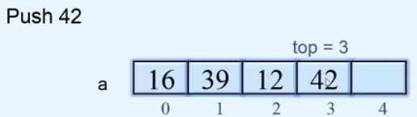
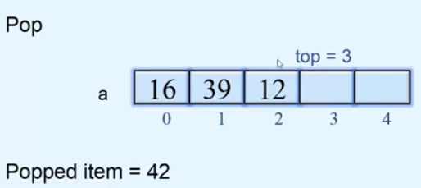
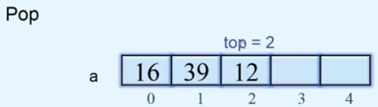
POP Operation on Stack
Popping the elements

Slide 15
Algorithm for POP Operation
Check Stack Underflow condition
  If(top== -1)
  Then print stack is underflow
Otherwise, delete the top position element
  Popped_item=stack_arr[top]
Decrease the position of top
  top=top-1
Print the popped_item

Slide 16
Try writing the code for Pop Operation function

Slide 17
POP Operation
pop()
{
if(top == -1)
printf("Stack Underflow\n");
else
{
printf("Popped element is : %d\n",stack_arr[top]);
top=top-1;
}
}/*End of pop()*/

Slide 18
Try writing the code for Display Operation function

Slide 19
Display fn
display()
{
int i;
if(top == -1)
printf("Stack is empty\n");
else
{
printf("Stack elements :\n");
for(i = top; i >=0; i--)
printf("%d\n", stack_arr[i] );
}
}/*End of display()*/

Slide 20
Peek Operation
An operation on certain abstract data types, specifically sequential collections such as stacks and queues,
  which returns the value of the top ("front") of the collection
  without removing the element from the collection.
  It thus returns the same value as operations such as "pop" or "dequeue", but does not modify the data.

Slide 21
Peek Operation
The name "peek"
  the name for this operation varies depending on data type and language.
Peek is generally considered an inessential operation,
  not included in the basic definition of these data types.

Slide 22
Peek Operation
Sequential types for which peek is often implemented include:
  Stack
  Queue
  Priority queue (such as a heap)
  Double-ended queue (deque)
  Double-ended priority queue (DEPQ)

Slide 23
Peek Operation
Single-ended types, such as stack,
  generally only admit a single peek, at the end that is modified.
Double-ended types, such as deques,
  admit two peeks, one at each end.
Names for peek vary.
  For queues "front" is common.
  Dequeues have varied names, often "front" and "back" or "first" and "last".
  The name "peak" is also occasionally found

